Slide 1
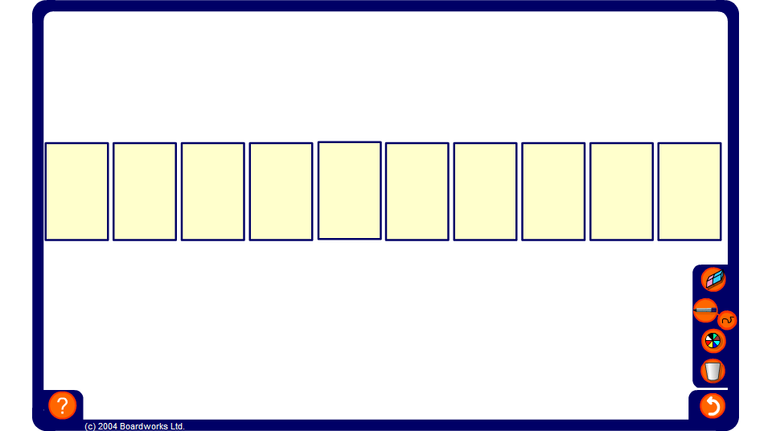


Higher or lower
Notes:
Start by revealing the first card and asking the class to predict whether the next card will be higher or lower? How often can pupils correctly predict whether the next card will be higher or lower? When can they be completely sure of their answer?
Discuss strategies. Strategies may improve as you play more than once; for example, are pupils taking into account all the cards already turned over, or just the last one turned?

